Slide 1
FOOD AND BEVERAGE INDUSTRY ANALYSIS USING POWER BI
PRESENTED BY: SHREYA GAUTAM

Slide 2
Introduction
The food and beverage industry covers the full spectrum from production to retail, driven by growing global populations and rising incomes. Key trends include a shift toward healthier, organic products and increased focus on sustainability, with many companies adopting eco-friendly practices. Technological advancements, such as automation and e-commerce, are reshaping the sector. Challenges like supply chain disruptions and intense competition persist, but opportunities remain in product innovation and expanding into new markets. Embracing digital sales channels further enhances growth potential. Overall, the industry is evolving rapidly with substantial prospects for adaptation and success

Slide 3
PROJECT OVERVIEW
This Power BI project focuses on analyzing survey responses from the food and beverage industry to gain insights into consumer behavior, preferences, and brand perceptions. By examining data across different demographics, the project aims to identify key trends, understand consumer attitudes, and pinpoint areas for improvement in products and marketing strategies.
The findings will provide actionable recommendations for refining product offerings and marketing approaches. This will enable businesses to better align their strategies with consumer expectations, enhance market positioning, and drive growth in the competitive food and beverage sector.

Slide 4
Data Description
Fact Table: fact_survey_responses
• Response_ID: Unique identifier for each survey response.
• Respondent_ID: Unique identifier for each respondent.
• Consume_frequency: Frequency of consumption of food and beverage products.
• Consume_time: Typical time when the products are consumed.
• Consume_reason: Reasonsfor consuming the products.
• Heard_before: Whether the respondent has heard of the product before.
• Brand_perception: Respondent's perception of the brand.
• General_perception: Overall perception of the food and beverage industry.
• Tried_before: Whether the respondent has tried the product before.
• Taste_experience: Respondent's experience with the taste of the product.
• Reasons_preventing_trying: Reasons preventing respondentsfrom trying the product.
• Current_brands: Brands currently consumed by the respondent.
• Reasons_for_choosing_brands: Reasonsfor choosing specific brands.
• Improvements_desired: Improvements desired in products.
• Ingredients_expected: Expected ingredients in products.
• Health_concerns: Health concernsrelated to products.
• Interest_in_natural_or_organic: Interest in natural or organic products.
• Marketing_channels: Preferred marketing channels for product information.
• Packaging_preference: Preferencesfor product packaging.
• Limited_edition_packaging: Interest in limited edition packaging.
• Price_range: Preferred price range for products.
• Purchase_location: Typical locations where products are purchased.
• Typical_consumption_situations: Common situationsin which products are consumed.

Slide 5
Dimension Table: dim_respondent
• Respondent_ID: Unique identifier for each respondent.
• Name: Name of the respondent.
• Age: Age of the respondent.
• Gender: Gender of the respondent.
• City_ID: Identifier linking the respondent to a city.
Dimension Table: dim_cities
• City_ID: Unique identifier for each city.
• City: Name of the city.
• Tier: Tier classification of the city (e.g., Tier 1, Tier 2).

Slide 6
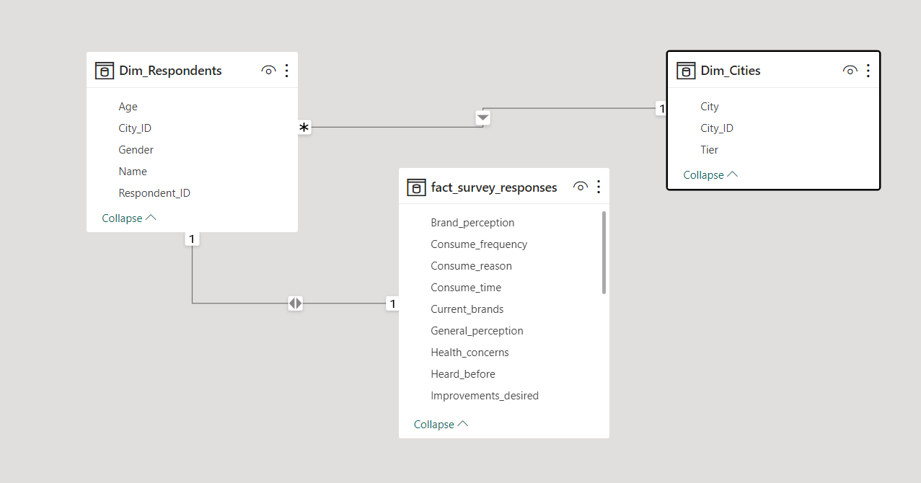
MODEL VIEW OF DATA AND TABLES

Slide 7
DATA OVERVIEW
• Current_brands: Brands currently consumed by the respondent.
• Reasons_for_choosing_brands: Reasonsfor choosing specific brands.
• Improvements_desired: Improvements desired in products.
Ingredients_expected: Expected ingredients in products.
• Health_concerns: Health concernsrelated to products.
• Interest_in natural_or_organic: Interest in natural or organic products.
• Marketing_channels: Preferred marketing channels for product information.
• Packaging_preference: Preferences for product packaging
• Limited_edition packaging: Interest in limited edition packaging.
• Price_range: Preferred price range for products.
• Purchase_location: Typical locations where products are purchased.
• Typical_consumption_situations: Common situations in which products are

Slide 8
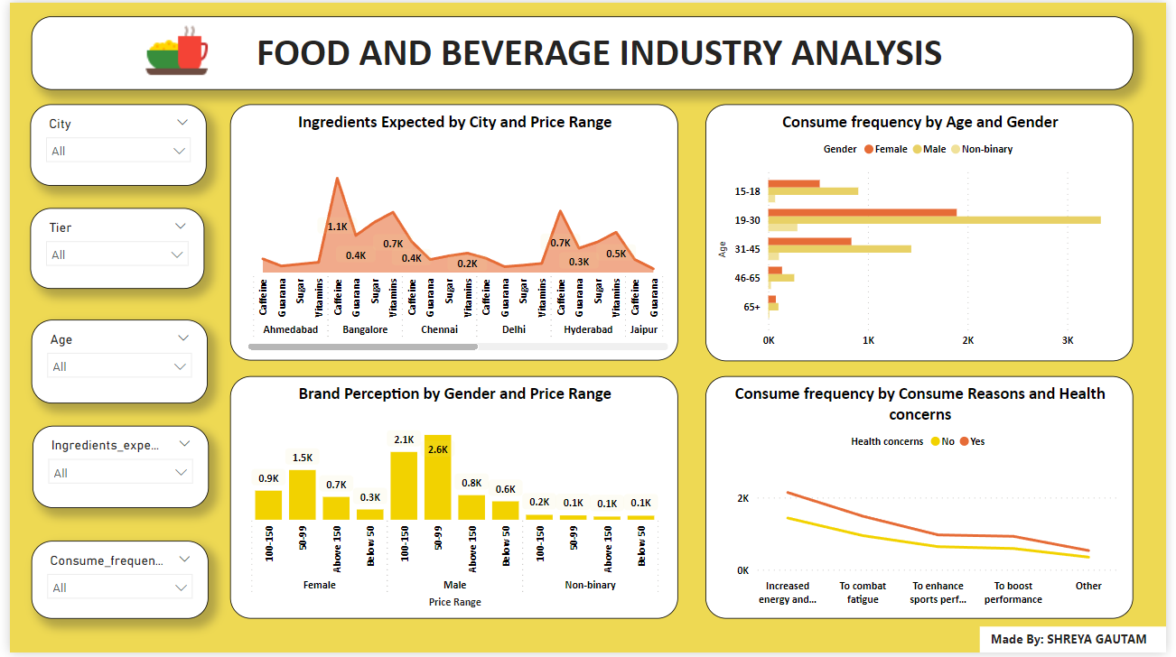
POWER BI DASHBOARD 1

Slide 9
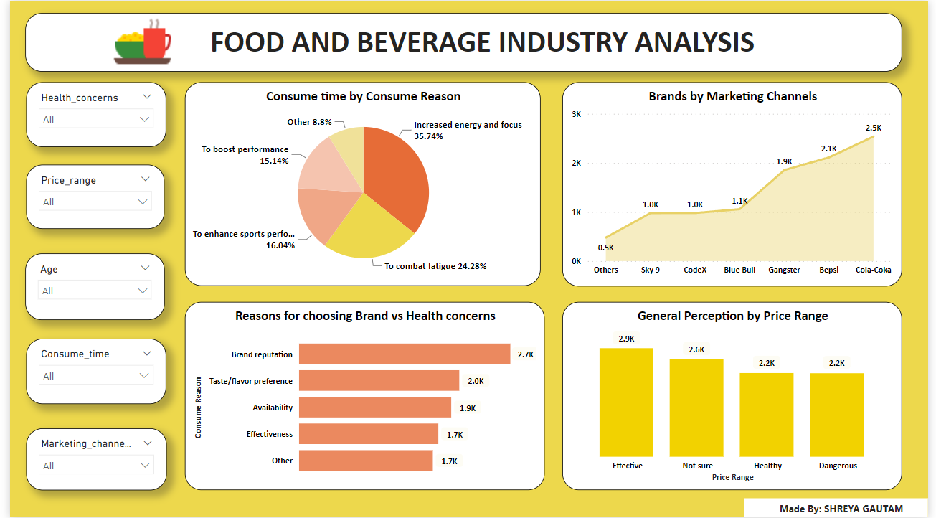
POWER BI DASHBOARD 2

Slide 10
INSIGHTS
49.83% of respondents are interested in natural or organic products and 30.62% are not interested in natural or organic products and 19.55% are not sure about it.
Most respondents improvement desired is to reduce suger content .
Most number of respondents are between age of 19-30 and lowest are of 65+.
Most respondents wants Compact and portable cans as packaging preference.
Most number of respondents are from Bangalore and lowest are from Lucknow.
Younger consumers (15-30) show a more positive perception, which might suggest that targeting marketing efforts towards these groups could be beneficial

Slide 11
INSIGHTS
Products are consumed mostly 2-3 times a week by respondents.
Caffeine ingredient expected is most by the respondents.
Most number of reason for choosing brand by respondents is Taste/flavour.
55.53% of respondents have heard before about our brands and 44.47% respondents haven’t heard about our brands before.
Most number of respondents purchase from supermarkets.
Online ads is mostly chosen by the respondents.
51.19% of respondents have tried before our brands and 48.81% of respondents haven’t tried brand before (Cola coka brand is most tried brand before by respondents among all brands ).
Nearly half (49.83%) of the respondents prefer natural or organic products, which is a significant market trend

Slide 12
CONCLUSIONS
The analysis of survey data from the food and beverage industry has provided valuable insights into consumer behavior, preferences, and brand perceptions. By identifying key trends and understanding consumer attitudes, the project has highlighted areas where product offerings and marketing strategies can be enhanced. The actionable recommendations derived from this analysis will help businesses align more closely with consumer needs, optimize their market strategies, and improve overall customer satisfaction. Ultimately, this project equips industry stakeholders with the knowledge to make informed decisions, drive strategic improvements, and strengthen their competitive position in the market.

Slide 13
THANK YOU

